Slide 2
ACIDOSIS & ALKALOSIS
BY Dr. Naglaa Ibrahim Azab
Assistant professor of medical biochemistry

Slide 3
Acidosis
Blood PH tend to ↓
Results from formation of excessive acids
More than the capacity of the body to eliminate them
Respiratory acidosis
Metabolic acidosis

Slide 4
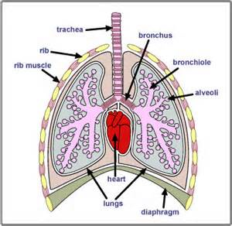
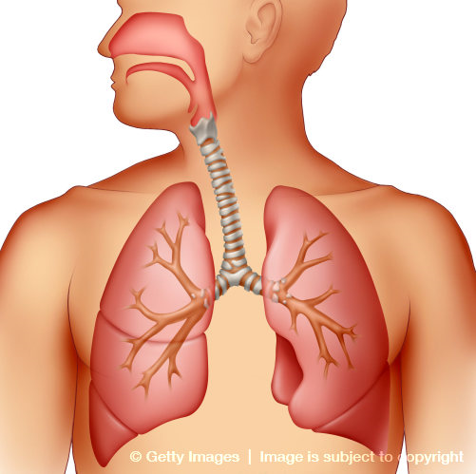
Respiratory acidosis
↑CO2 (CO2 RETENTION) due to
Bronchial asthma
Chronic bronchitis
Emphysema
Pneumonia
Respiratory centre inhibition
Asphexia
↑CO2 → ↑ blood H2CO3

Slide 5
Respiratory acidosis
↑CO2 ↑ blood H2CO3
HCO3¯ not changed
→ ↓ HCO3¯/H2CO3 (N=20:1)
→ ↓blood PH
(Uncompensated respiratory acidosis [acidemia])
How to compensate?
Kidney reabsorbs more HCO3¯
Till normal HCO3¯/H2CO3 (20:1)
→ PH reach 7.4

Slide 6
Metabolic acidosis
↑ acids or ↓ bases (HCO3¯) in blood
↓ blood HCO3¯
blood H2CO3 not changed
→ ↓ HCO3¯/H2CO3 (N=20:1)
→ ↓blood PH
(Uncompensated metabolic acidosis [acidemia])
How to compensate?
↓ PH→ ++ chemoreceptors in respiratory centre→ hyperventilation→ loss of CO2→↓H2CO3
Till normal HCO3¯/H2CO3 (20:1)
→ PH reach 7.4 (Compensated metabolic acidosis )

Slide 7
Metabolic acidosis
But the alkali reserve is ↓
How to retain?
Healthy kidney not excrete HCO3¯ (Not in hyperkalemia)
Na will be absorbed in the form of NaHCO3
→ alkali reserve return to normal

Slide 8
Causes of Metabolic acidosis
1- ↑blood acids
↑production
↓excretion
↑ lactic acid in muscular exercise
↑ ketone bodies (as acetoacetic acid &β- hydroxy butyric acid) in Ketosis due to Diabetes mellitus
↑ acids from metabolism of different food stuffs (diet) as pyruvic , lactic, sulfuric, phosphoric and nucleic acids.
Adminstration of NH4Cl
→ Cl¯ replace HCO3¯
NH4⁺ transformed into urea
↑ fatty acids, uric acids & phosphoric acid due to failure of excretion by the kidney in chronic renal failure

Slide 9
Causes of Metabolic acidosis
1- ↑ base loss
Diarrhea: Intestinal juices are alkaline being rich in Na⁺ & K⁺ bicarbonate
Vomiting: due to low intestinal obstruction
Hyperkalemia:
*↑renal tubular reabsorption of Na⁺ in exchange with K⁺
→ stop of Na⁺/ H⁺ exchange
* Na⁺ reabsorption will be in the form of NaCl not NaHCO3 > HCO3‾ will be excreted in the form of KHCO3 in urine.
HCO3‾ loss in urine → metabolic acidosis (Alkaline urine)
↑ Cl in blood→ hyperchloremic acidosis (Acidic blood)
The alkaline urine& acidic blood is called paradoxical acidosis
Notes:
acidosis

Slide 10
Causes of Metabolic acidosis
1- ↑blood acids
Tubular lumen
Tubular cell
blood
NaHCO3 Na⁺
H⁺
HCO3 ⁻
H2CO3
CO2+H2O
Na⁺
H⁺ + HCO3¯
H2CO3
CO2+H2O
Na⁺
HCO3¯
NaHCO3 ¯
(Filtered)
CA
CA

Slide 11
Causes of Metabolic acidosis
1- ↑blood acids
Tubular lumen
Tubular cell
blood
Cl‾
NaHCO3 Na⁺
K⁺
HCO3 ⁻
KHCO3
Cl‾
Na⁺
K⁺
Cl‾ NaCl
Na⁺
K⁺
(Filtered)

Slide 12
Alkalosis
Blood PH tend to ↑
Results from formation of excessive bases
More than the capacity of the body to neutralize & eliminate them
Respiratory alkalosis
Metabolic alkalosis

Slide 13
Respiratory alkalosis
↑ CO2 loss due to
fever
encephalitis
high altitude
late stages of salicylate poisoning
hystrical hyperventilation
↓CO2 → ↓ blood H2CO3

Slide 14
Respiratory acidosis
↓CO2 ↓ blood H2CO3
HCO3¯ not changed
→ ↑ HCO3¯/H2CO3 (N=20:1)
→ ↑ blood PH
(Uncompensated respiratory alkalosis [alkalemia])
How to compensate?
-- of renal tubular reabsorption of HCO3¯
Kidney excretes more HCO3¯
Till normal HCO3¯/H2CO3 (20:1)
→ PH reach 7.4
(Compensated respiratory alkalosis)
Urine will be alkaline because of ↑ secretion of K⁺ & HCO3‾ in urine

Slide 15
Metabolic alkalosis
↑ bases or ↓ acids in blood
↑ blood HCO3¯
blood H2CO3 not changed
→ ↑ HCO3¯/H2CO3 (N=20:1)
→ ↑blood PH
(Uncompensated metabolic alkalosis [acidemia])
How to compensate?
↑ PH→ - - - chemoreceptors in respiratory centre→ hypoventilation→ CO2 retention →↑H2CO3
Till normal HCO3¯/H2CO3 (20:1)
PH reach 7.4 (Compensated metabolic alkalosis )
How to correct for ↑ alkali reserve?

Slide 16
Metabolic alkalosis
How to correct for ↑ alkali reserve?
kidney ↑Na⁺/K⁺exchange so – Na⁺/H ⁺ exchange → excretion of HCO3‾ in the form of KHCO3
reabsorption of Cl⁻ in the form of NaCl
→ alkali reserve return to normal

Slide 17
Causes of Metabolic alkalosis
1- ↑absorption of bases
Intake of high vegetable and fruit diet: They contain Bicarbonate salts and citrate salts. Citrate salts will be transformed into bicarbonate salts by krebs cycle
Intake of drugs containing bicarbonate & citrate salts (drugs used for treatment of hyperacidity & peptic ulcer)

Slide 18
Causes of Metabolic alkalosis
2- ↑loss of acids
Prolonged suction of gastric juice
Vomiting due to high intestinal obstruction: loss of Cl ⁻in vomitus→ replacement by HCO3 ¯ coming from the stomach to the blood→ ↑ HCO3 ¯in blood→ metabolic alkalosis
Hypokalemia:
*↓renal tubular reabsorption of Na⁺ in exchange with K⁺
→ instead there is Na⁺/ H⁺ exchange
* Na⁺ reabsorption will be in the form of NaHCO3 not NaCl →
# Cl‾ loss in urine in the form of NH4Cl→ hypochloremia and acidic urine
↑ NaHCO3 in blood→ alkalosis(alkaline blood)
The alkaline urine& acidic blood is called paradoxical alkalosis
Cushing syndrome: →Na& water retention & K excretion→ hypokalemia

